Slide 1




Mini Project ( SEM-3)
Project Title –
AI Buddy

Slide 2
Project By -
Anurag Jadhav

Slide 3
Introduction
A AI Buddy is a software application used to conduct an online chat conversation via text or text-to-speech in place of providing direct contact with a live human agent. It can help customers by automating conversations and interacting with them through messaging platforms. Designed to simulate how a human behaves as a conversational partner convincingly.
With the help of AI modules it can use human input to give appropriate solutions.

Slide 4
Objective
Assist human in creating programs with lower functionality and ease our life.
Create solution which are user friendly and in human readable format.

Slide 5
Proposed System
A AI Buddy project is built using artificial algorithms that analyzes user's queries and understand user's message. This System is a web application which provides answer to the query of the User. User just have to query through the UI which is used for chatting and to retrive information which we required.

Slide 6
Scope
The scope of work for AI Buddy is to provide a natural language processing (NLP) platform that enables users to create and deploy conversational AI applications. This includes the development of an NLP engine, training data sets, and tools for creating and managing conversations.

Slide 7
Modules
Chat interface.
Feedback management.
Google Authentication.
Connection of OpenAI API.
Control module.

Slide 8
Technologoy Used.
Frontend/Gui – Html, Css, Javascrpit.
Backend – Node JS, Vite (JS framework), OpenAI , Express , Cors.

Slide 9
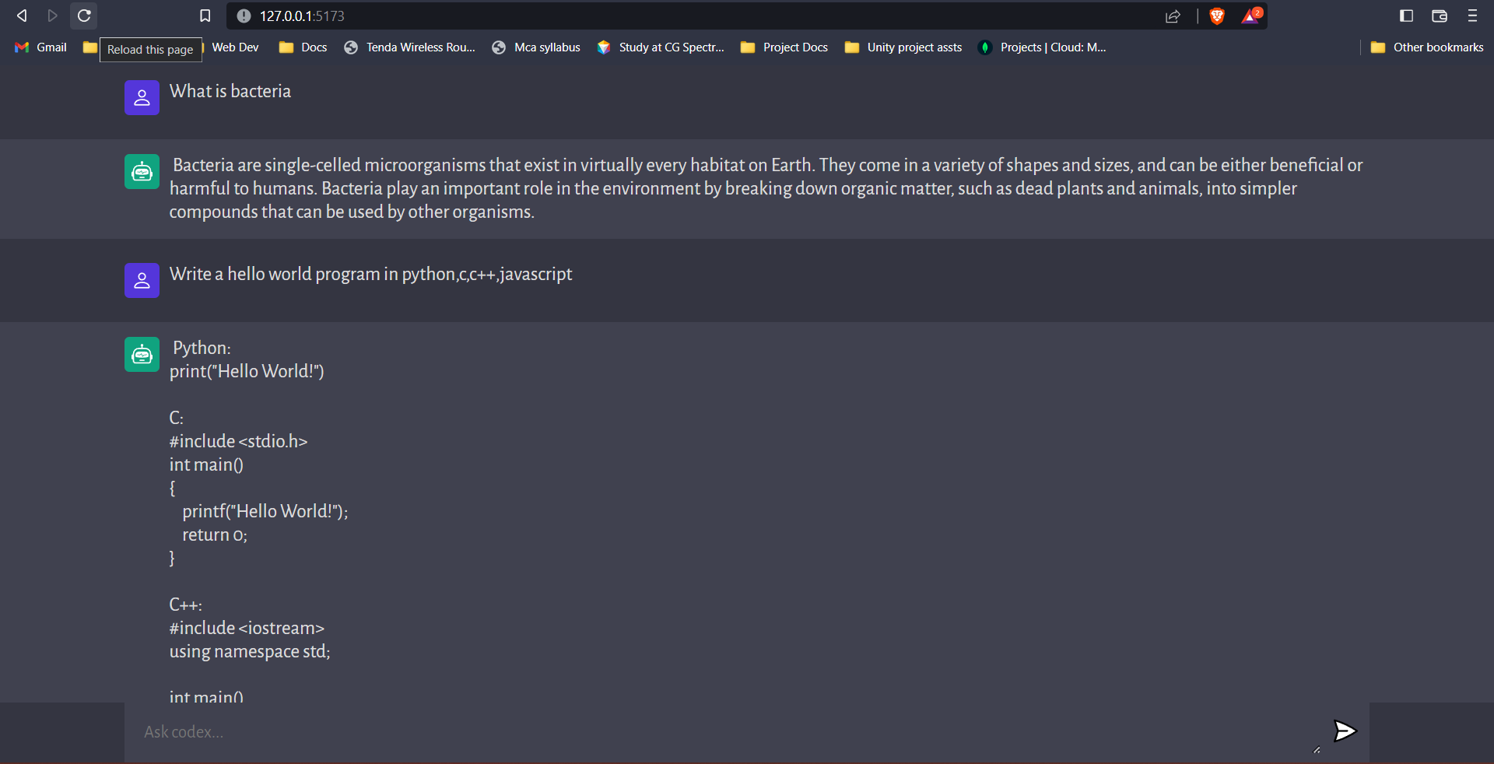
Snapshot

Slide 10
Conclusion
In conclusion, AI Buddy is a powerful tool for analyzing and understanding natural language data. It can be used to extract meaningful insights from large amounts of text data, as well as to generate new content. With the right tools and techniques, it can help Programmers gain valuable insights into their coding work or information which will be required to User. As the technology continues to evolve, we will likely see more applications of NLP in various industries.

Slide 11
Thank You.

